Slide 1
Community Basics
Replying to a Post

Slide 2
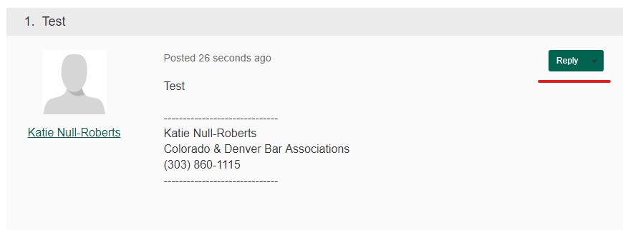
Choose the post you’d like to reply to, click ‘Reply’

Slide 3

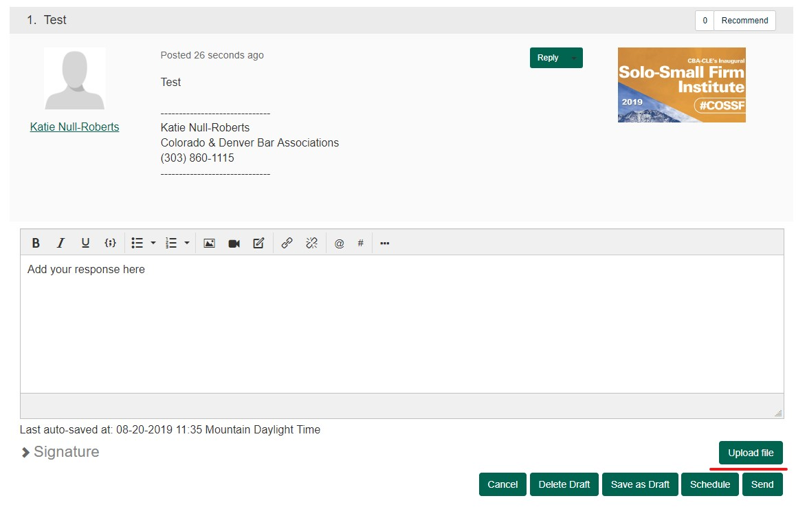
Add your response to the message body

Slide 4
To upload an attachment, click ‘Upload file’

Slide 5
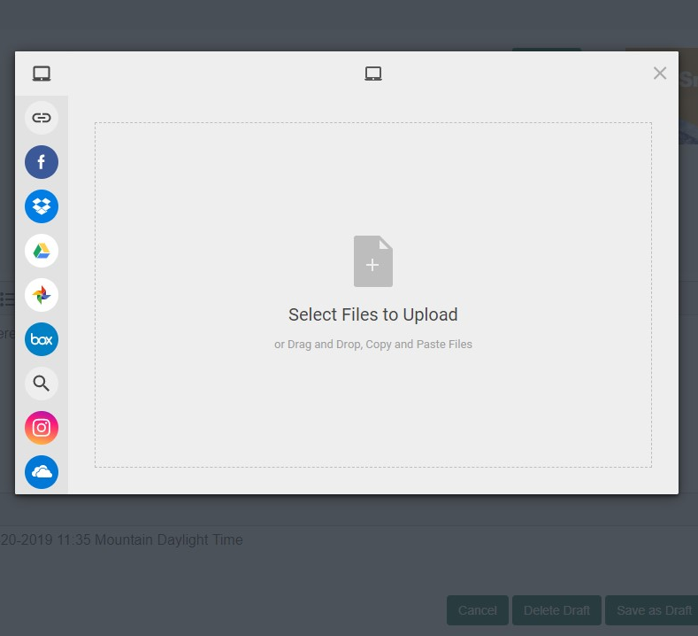
Drag and drop or copy and paste your attachment.

Slide 6
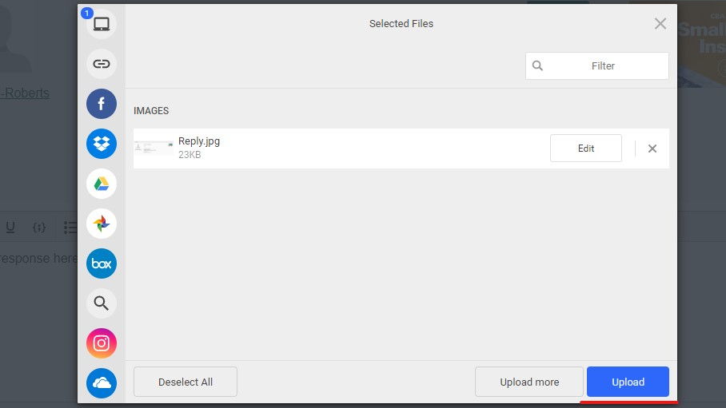

Slide 7
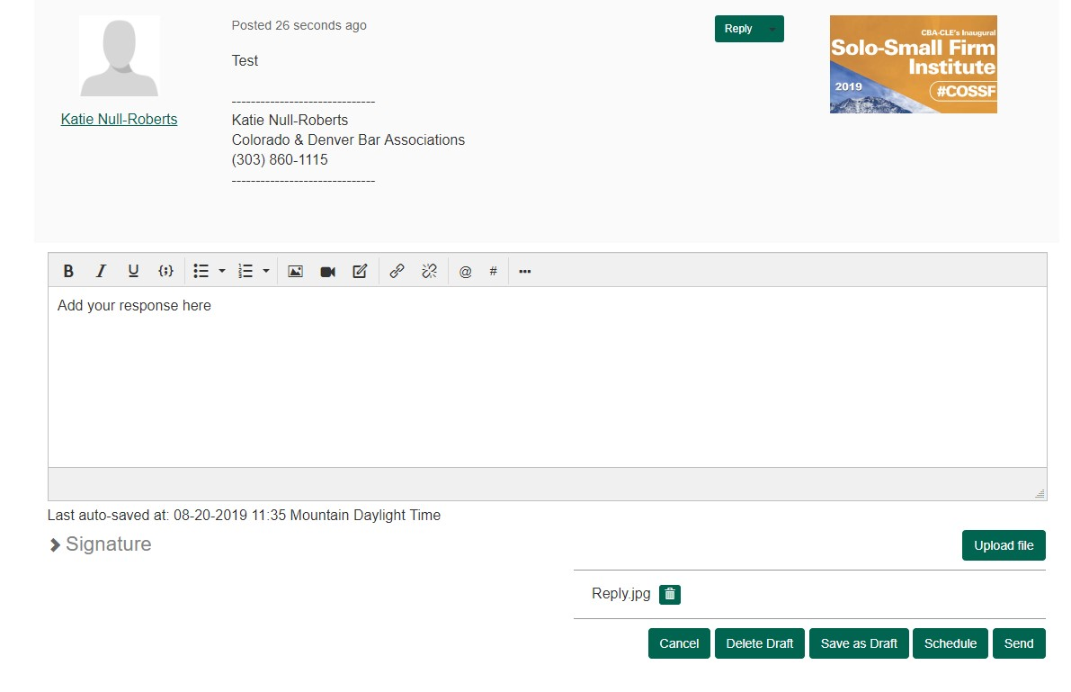
When your attachment has been successfully attached, your post screen should look like this:

Slide 8
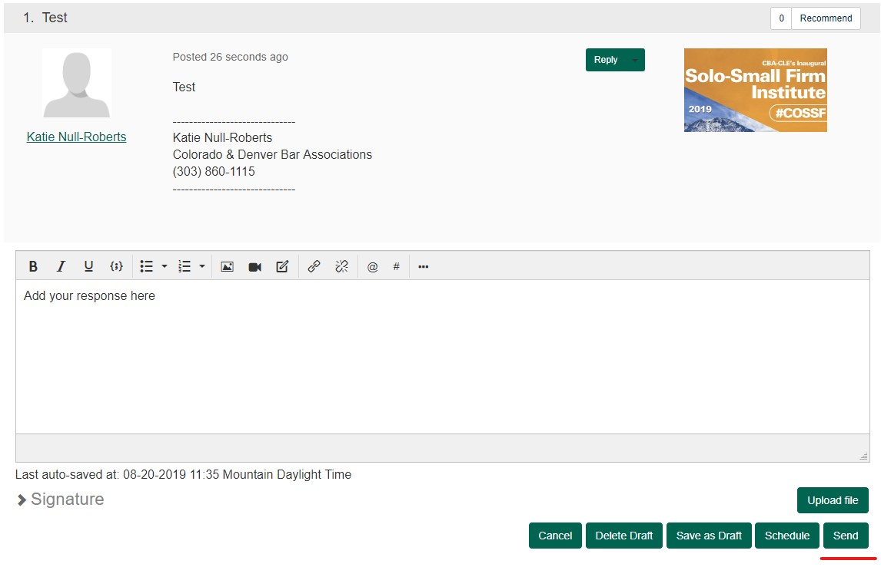
Click ‘Send’ to post your reply.

